Slide 1
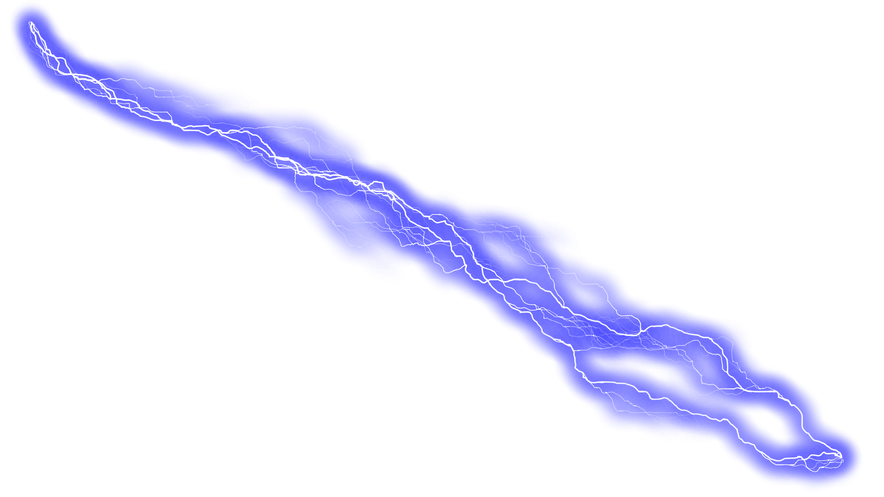
Electricity at Play
By: IEEE at UCF

Slide 2
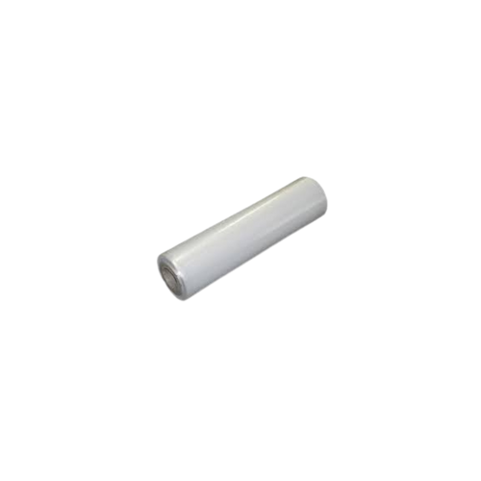
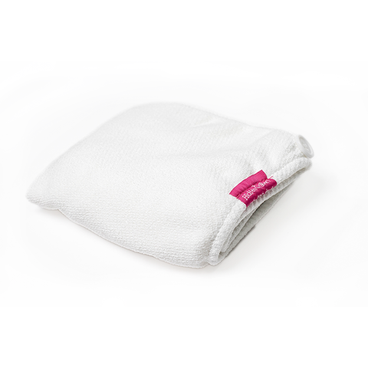
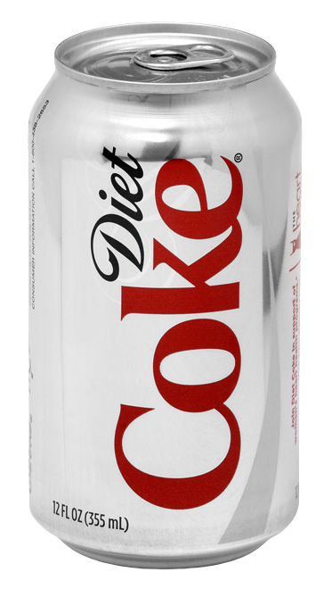
Can Can Go? - Setup
PVC Pipe
Aluminum Can
Cloth

Slide 3
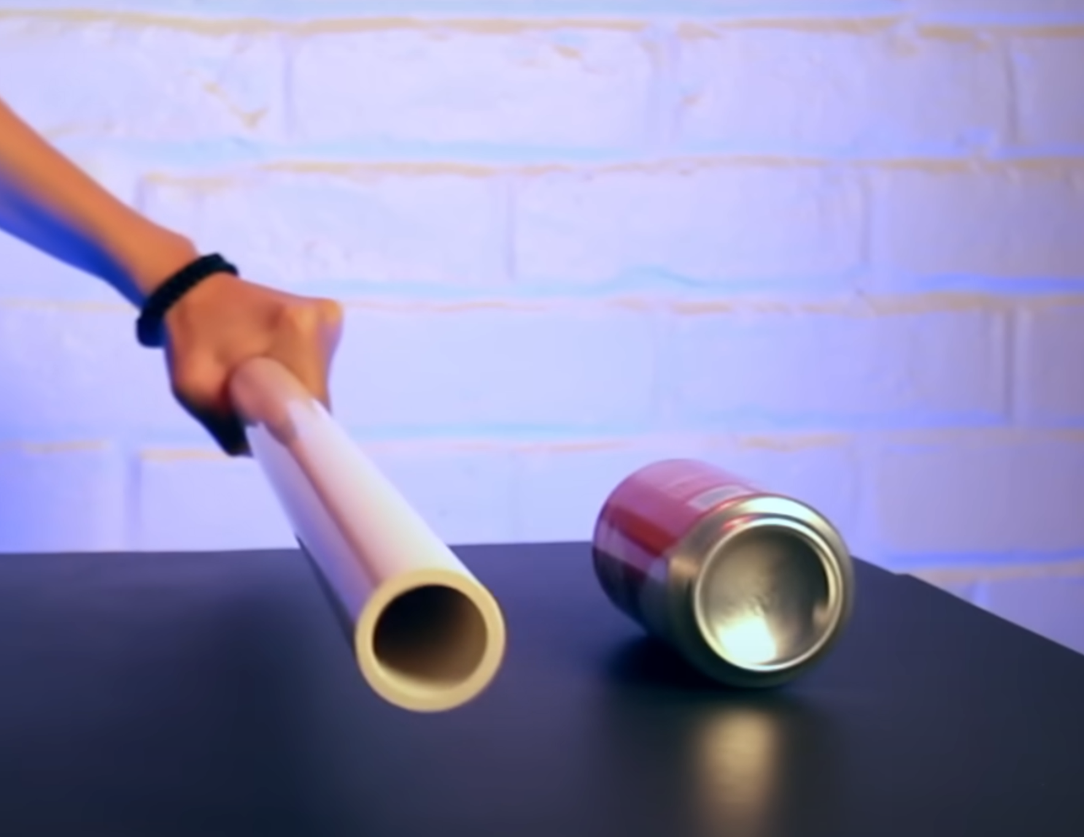
Can Can Go? - Procedure
Lay the can onto its curved side on a table
Wrap the cloth around the pipe’s shaft and rub the pipe back and forth with the cloth
Hold the pipe with its curved side facing the can’s curved side
Move the pipe towards and away from the can and watch what happens!

Slide 4
Can Can Go? - Explanation
When you rub the pipe with the cloth, the electrons from the cloth are transferred to the pipe, making the pipe negatively charged.
Metals like aluminum have lots of electrons, so when the pipe gets close to the can, the electrons on the pipe and can repel each other.
-
-
-
-
-
-

Slide 5
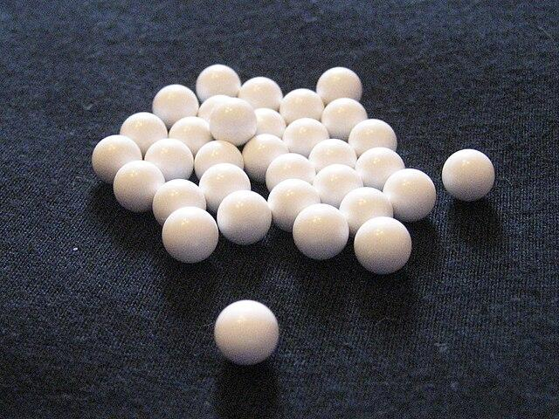
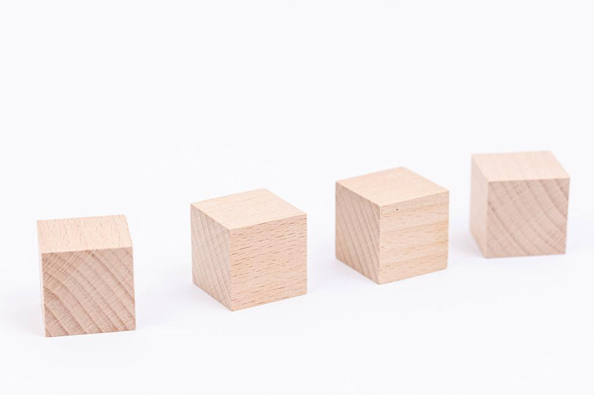
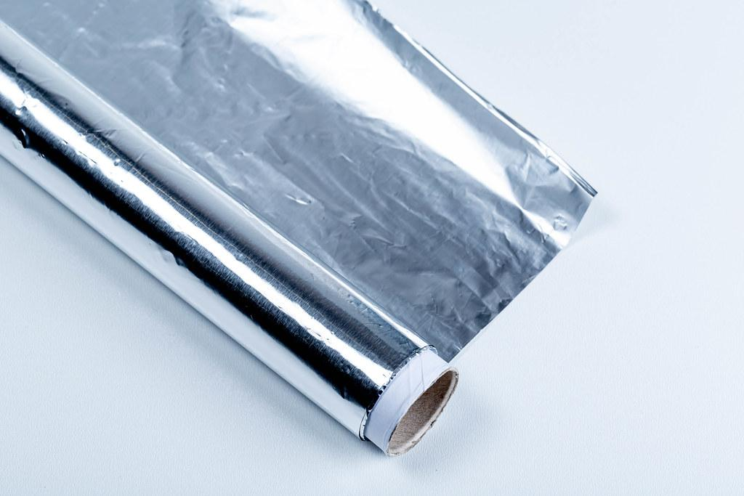
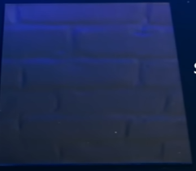
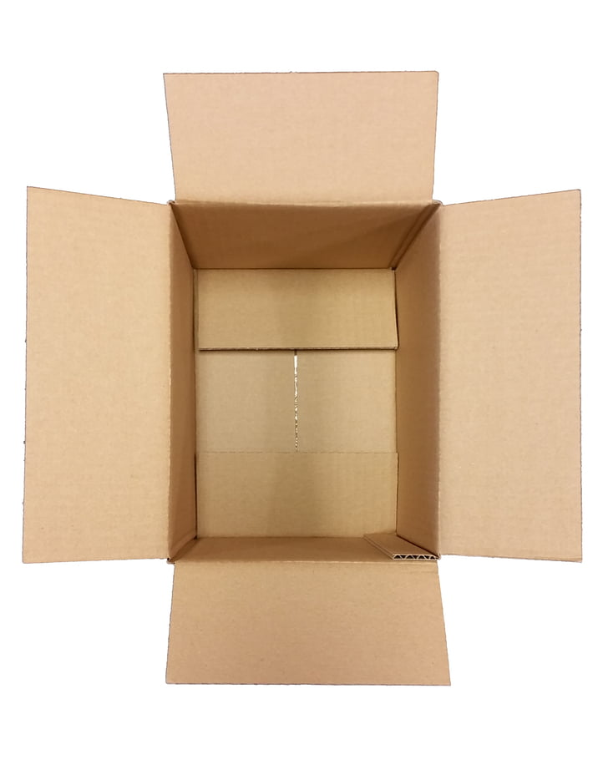
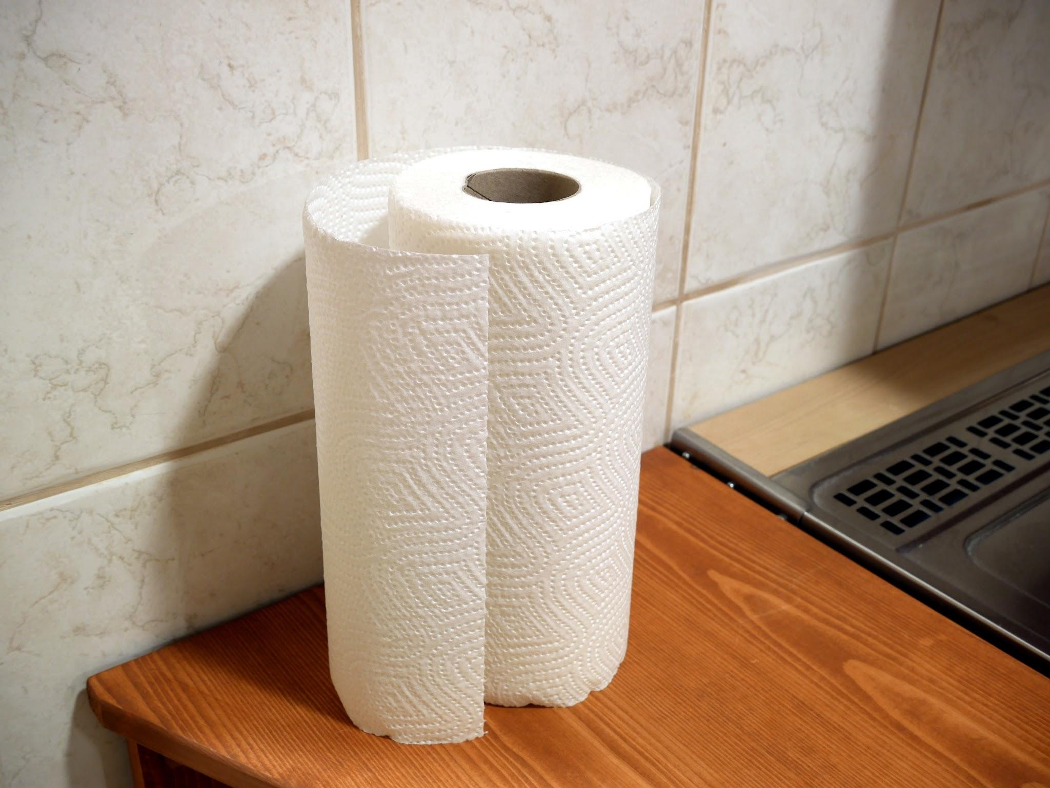
Magic Balls - Setup
Foam Balls
Foil
Blocks
Invisible Sheet
Cardboard
Cloth

Slide 6
Magic Balls - Procedure
Get one foam ball and wrap around foil.
Repeat step 1 until you have 6 foil balls.
Use your cardboard box and place large foil sheet on base.
Put 4 blocks in each corner.
Put invisible sheet on four blocks.
Rub invisible sheet with cloth.
Place foil balls on invisible sheet surface.
Point finger at balls and watch the magic balls fly!

Slide 7
Magic Balls - Explanation
When you rub the surface with a cloth it creates a static charge. This static charge has negative electrons.
When neutral charged foil balls touch the surface they start moving around from negative electrons and won’t stop till they become neutral again.
By bringing your finger close to the ball it will once again unbalance the charges on the foil ball causing them to move around crazy!

Slide 8
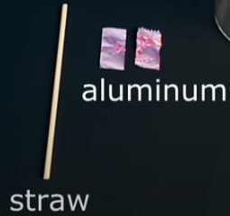
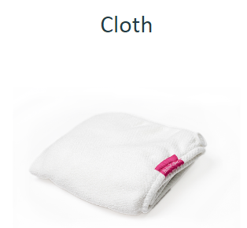
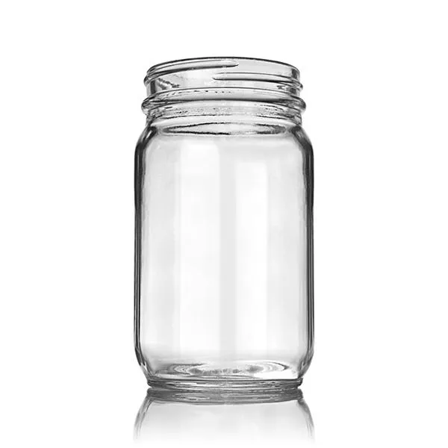
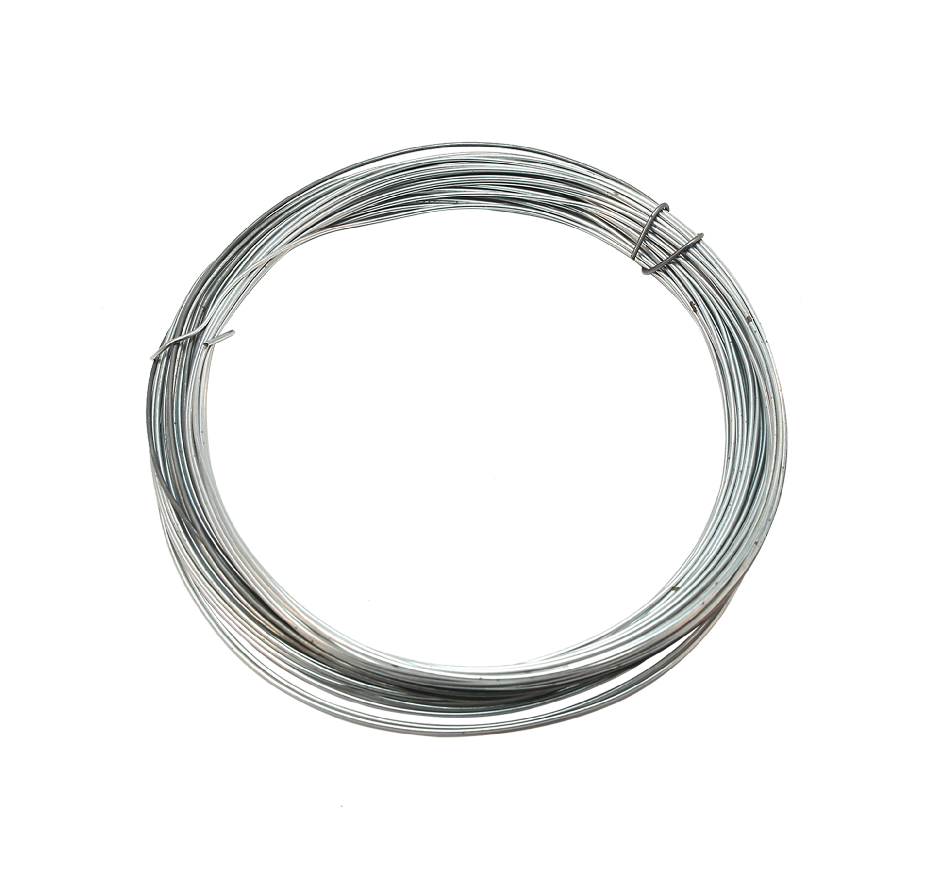
Wingardium Leviosa - Setup
PVC Pipe
Glass Jar
Steel Wire

Slide 9
Wingardium Leviosa - Procedure
Assemble the Wingardium
Make a hook out of the steel wire
Mount aluminum foil on the hook
Close lid of the jar with the wire and aluminum inside
Use string to have wire come out of the lid
Wrap the cloth around the pipe’s shaft and rub the pipe back and forth with the cloth
Place the pipe near the exposed steel wire and watch the spell do its magic!

Slide 10
SIKE, Just Kidding. It's not magic:
It’s Science

Slide 11
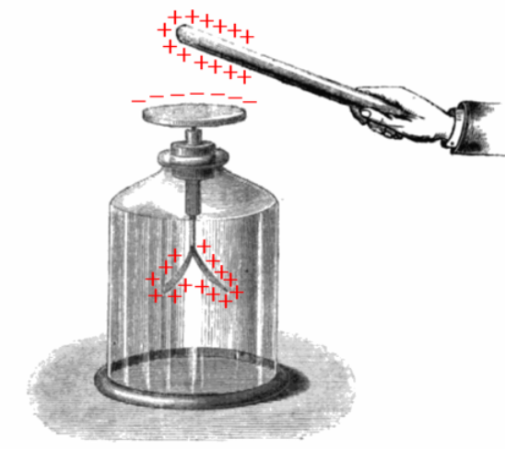
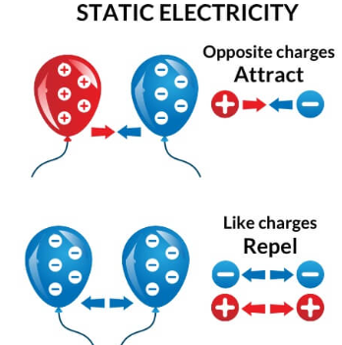
Wingardium Leviosa - Explanation

